Slide 1
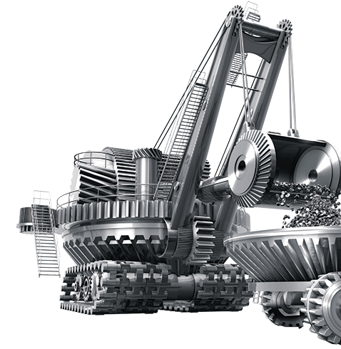
The mining industry
driven by David Brown

Slide 2
Revision control
Revision | Section | Page | Description | Date | Up-issued by
A | Initial Issue |  | Initial Issue | 21/5/2013 | MH
B | Various | Various | Updated | 30/6/2014 | MH
C | Applications | 14 | Image updated | 23/7/2014 | MH
D | Various |  | General formatting | 11/11/2014 | MH

Slide 3

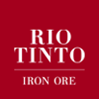







Customers

Slide 4
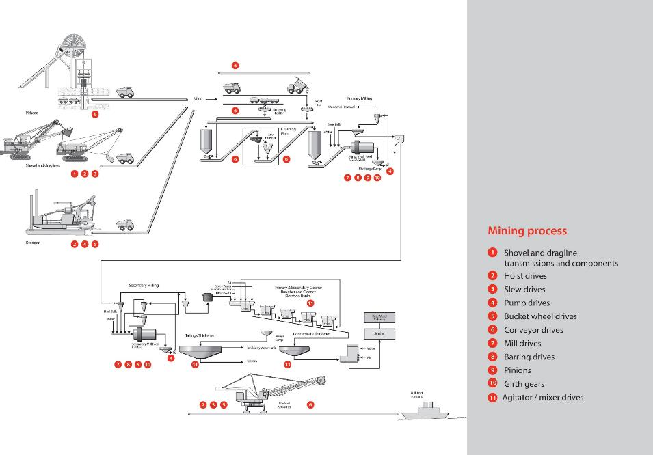
Global mining capabilities
Using our worldwide manufacturing resources, David Brown can supply gearboxes, gears and drive systems across the whole mining and mineral processing industry

Slide 5
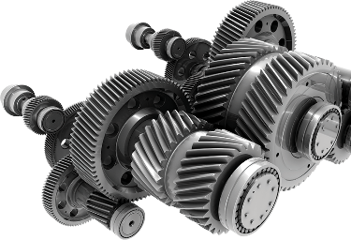
Services offered
Project studies by our project department
Rapid proposals
Validation of specifications
Gear design, manufacture and test
Complete project management
Assistance during installation and commissioning
Service support throughout the life of the gearbox
Specific solutions according to your needs

Slide 6
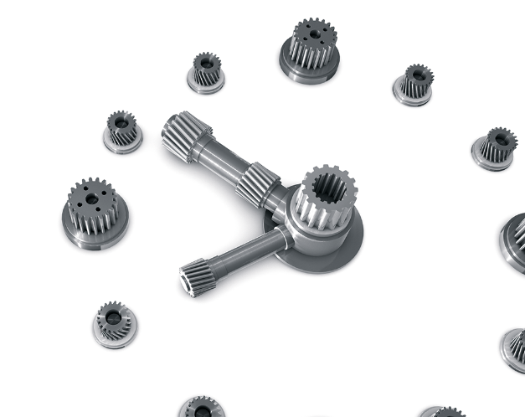
Gearboxes throughout their life cycle
6- Assistance with
installation and
commissioning
7- Parts replacement
In situ or in our
works
5- Optimisation of
your equipment
4- Repair and
maintenance
3- Manufacture – full in –house capabilities
2- Specific solutions
according to your
requirements
1- Analysis of project and Diagnostics

Slide 7
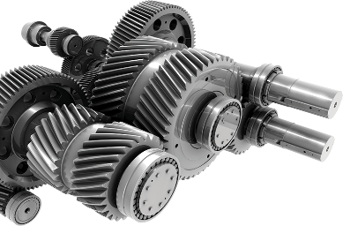
Management of your existing equipment
Expertise on site
Diagnostic testing in the workshop
Repair and refurbishment
Reconditioning
Improving reliability of equipment
Audit and plan maintenance
Turnkey service
All gearbox makes and models, not just David Brown brands
Responsibility and reactivity
We have service engineers throughout the world who can provide rapid on-the-ground support.

Slide 8
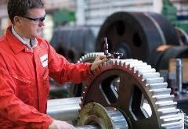
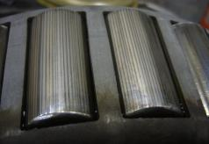
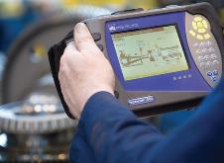
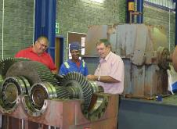
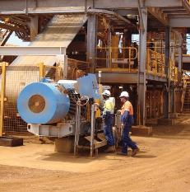
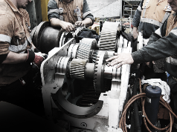
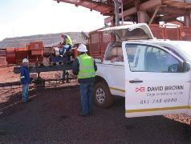
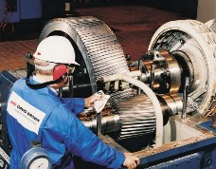
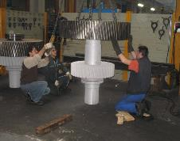
Gearbox service and repair
EXPERT SERVICE & REPAIR
IN HOUSE OR IN SITU

Slide 9
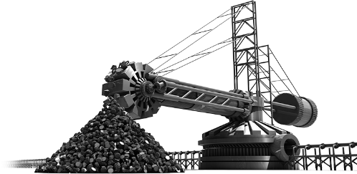
Mining Applications

Slide 10
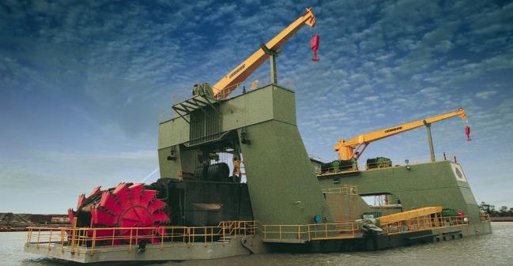
Dredger drives
Winch drives, pump drives and bucket wheel drives for large dredgers

Slide 11
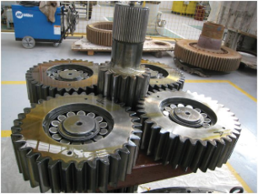
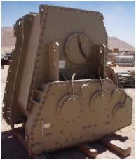
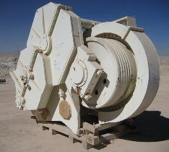
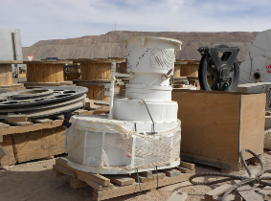
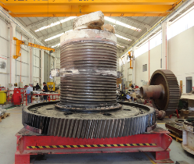
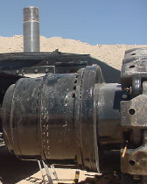
Gearing for shovels and draglines
Service and repair, upgrades and replacement units for gearing and gear units for all popular models of shovels and draglines.

Slide 12
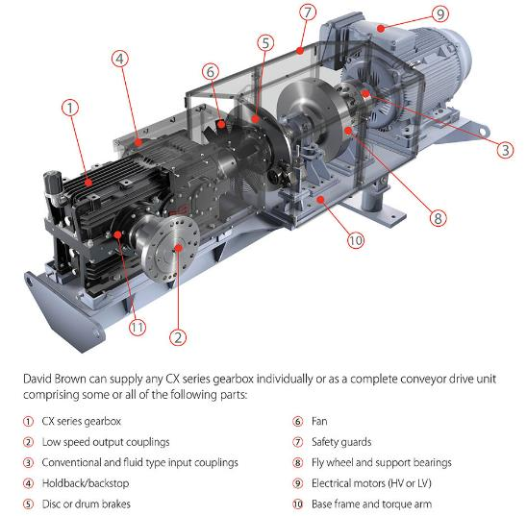
CX – conveyor drive
Our competitors offer a modified standard industrial reducer for this application. The CX range is entirely optimised for the specific range of duties and the specific product features needed for conveyor applications
In particular bearing lives and thermal ratings are well matched to the torque rating of the unit, typically giving a bearing life of 60,000 hours and a thermal rating higher than motor power without any external cooling (other than the integral fan)
David Brown can supply the entire package, as shown here.

Slide 13
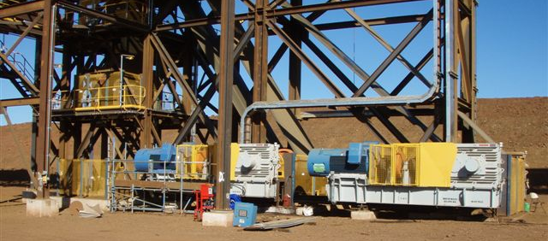
Conveyor drives
Conveyor drives consisting of gearbox, hold backs, brakes and fluid couplings for mineral transport systems to over 3000kW per unit
Drives can be load tested and measured prior to dispatch (temperature, noise, vibration)

Slide 14
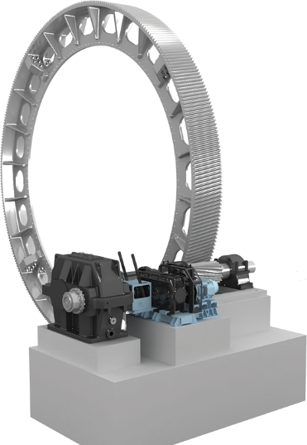
MDX – mill drive package
The MDX Mill Drive System can comprise all the elements shown here
David Brown is one of few manufacturers in the world capable of designing, manufacturing, installing and maintaining all these elements
This means we can be a “one stop shop” for a full system, keeping responsibility in one place
We can often optimise the individual components, matching ratios to our design and manufacturing capabilities, to give an optimum overall package
Girth gear
Mill drive unit
Mill pinion
Auxiliary mill drive (barring drive)

Slide 15
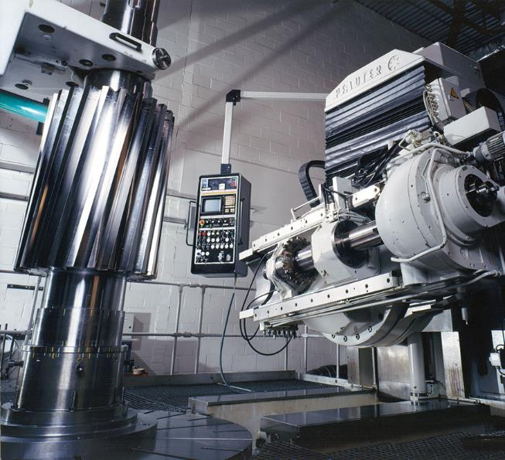
Mill pinions
David Brown can manufacture both integral and non-integral mill pinions
We can manufacture mill pinions up to 50 module, 4m in length and 1.2m face width
David Brown can manufacture mill pinions up to 10 tons in mass

Slide 16
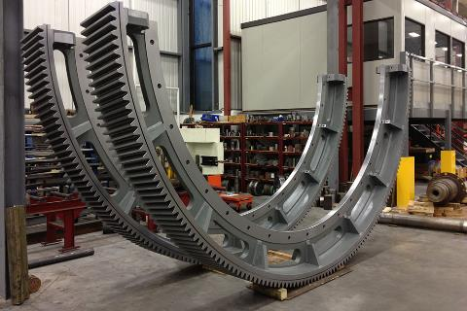
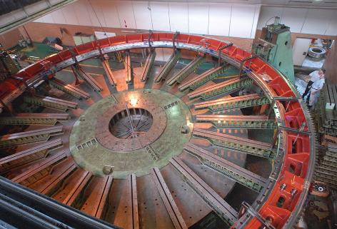
Girth gears
David Brown Girth Gears can be found in operation throughout the world
We can manufacture gears up to 14 meters in diameter and up 105 tonne in weight
Manufactured from cast (steel or SG Iron) or fabricated materials.
Gears fabricated using stress free hot forged segments.

Slide 17
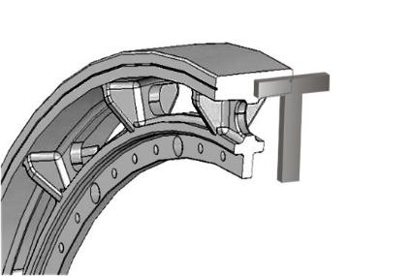
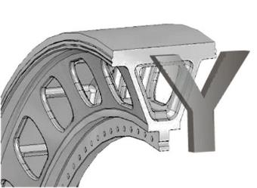
Girth gears
David Brown can manufacture both T and Y section gears
Girth Gears can be manufactured in 2,3,4,5,6 or 8 segments
Girth gears can be manufactured from either Cast Steel to BS3100 or Ductile Iron to ASTM A536
Girth Gears can be manufactured for hardnesses varying between 180- 320BHN
Fabricated gears from hot forged segments for low stress
T section gearing options
Y section gearing options

Slide 18
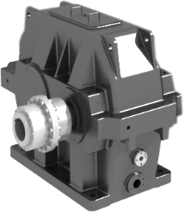
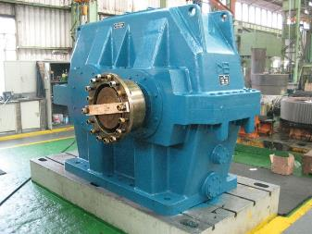
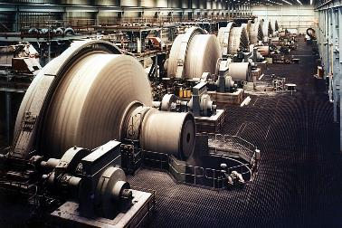
Mill drive units
David Brown has the design and manufacturing capability to supply gearboxes for mill drives up to 10MW capacity.
David Brown Mill drives are in use on Gold, Platinum and many other mines and plants
Can be either single or double reduction, depending on the required ratio and motor speed.
Triple reduction drives are available for Kiln and Dryers

Slide 19
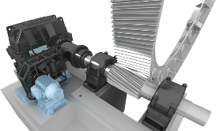
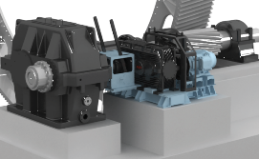
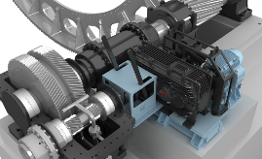
Mill drive units
Common features:
Cast iron case
Double helical carburised gears for long bearing life
Modular design allows for easy ratio changes
Special ratios designed to specification
Designed for a minimum of 52,000 hours L_{10h} basic bearing life
Single, double and triple reductions available.
Complete auxiliary/inching drives available as integral packages

Slide 20
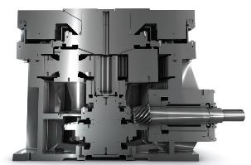
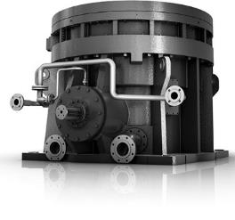
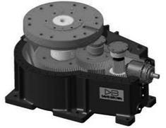
Pulveriser and crusher gearbox
David Brown can supply a range of gearboxes for pulverisers and crushers used in processing facilities

Slide 21
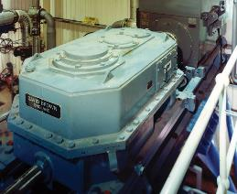
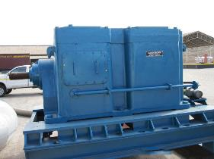
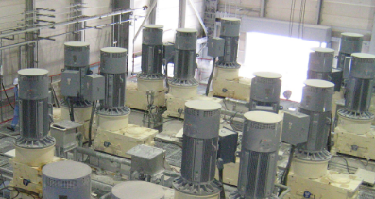
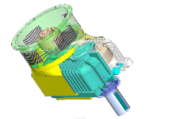
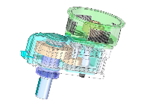
Mixers and agitators
Other mining products manufactured by David Brown include vertical drives for agitators, mixers and thickeners
New CVX agitator range

Slide 22
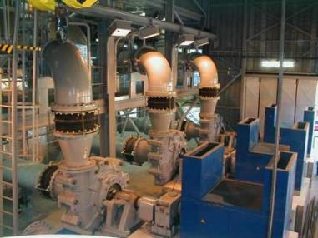
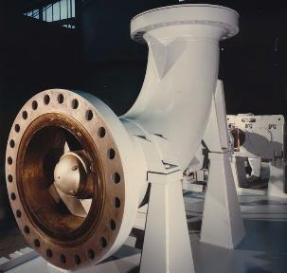
Slurry pump drives
David Brown manufactures high capacity single reduction slurry pump drives, rated from 160- 1050kW.

Slide 23
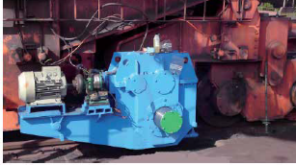
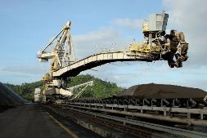
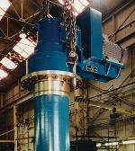

Stacker/Reclaimers
Conveyors
Bucket wheel
Slew drives
Travel drives

Slide 24
World Wide Mining Capabilities

Slide 25










Large gearboxes
If it has a large gearbox, we can provide a bespoke design and manufacture it

Slide 26


Worldwide design capabilities
David Brown mining products are designed using state of the art design software for gears, shafts and housings
CAD = Solid Edge, FEA = Ansys, Gear Design = Dontyne, Modelling = MASTA

Slide 27







Design Capability FEA and CFD

Slide 28



Optimisation
Gear alignment and micro-geometry optimisation
Improved load distribution, reduced noise and vibration
Bevel gear micro-geometry optimisation

Slide 29








FEA and NVH

Slide 30


Manufacturing capabilities
Global network of manufacturing sites
Mining centre of excellence in South Africa
Manufacture of gears up to 14m diameter
Manufacture of gearboxes to 150 tonnes in weight

Slide 31
Project References

Slide 32



Dredger drive for BHP
David Brown supplied a 140 tonne gearbox for one of the world’s largest dredgers
Customer: BHP, Australia

Slide 33




Conveyor drives
The CX series – a proven range of conveyor drive gearboxes designed specifically for mining applications
No external cooling or lubrication systems required
Increased reliability with no loss in performance
Double ended output and invertible design
Designed for minimal spares requirements
Tested and proved in Pilbara in 45deg+ ambient conditions

Slide 34



Conveyor drives
Recent references:
Client | Number of Drives | Size
Fortescue Metals Group (FMG) | 8 | 6 x 1000kW, 1 x 150kW, 1 x 630kW
Rio Tinto | 5 | 5 x 630 kW
Loy Yang Power | 1 | 1 x 185 kW
Xstrata | 4 | 2 x 220kW, 2 x 75kW
Maquire Generation | 1 | 1 x 370 kW
Fortescue Metals Group (FMG) | 2 | 1 x 630kW, 1 x 450kW
Rio Tinto | 20 | 2 x 900kW, 2 x 800kW, 9 x 710kW, 1 x 630kW, 5 x 560kW, 1 x 185kW
BMA (BHP and Mitsubishi) | 9 | 4 x 450kW, 3 x 280kW, 1 x 315kW, 1 x 132kW
PWCS (Port Warratah) | 6 | 3 x 800kW stealth, 3 x 630kW stealth
Fortescue Metals Group (FMG) | 38 | 5 x 1000kW, 4 x 710kW , 18 x 630kW, 6 x 450kW, 3 x 315kW
PWCS (Port Warritah) | 2 | 2 x 800kW stealth
Curragh Mine | 5 | 4 x 1000kW, 1 x 250kW
Millenium | 3 | 3 x 150kW
Xstrata | 6 | 2 x 220kW, 3 x 75kW, 1 x 90kW
Australian Coal Tech | 15 | 1 x 500kW, 1 x 315kW, 1 x 200kW, 3 x 110kW, 6 x 150kW,
Barclay Mowlem | 4 | 3 x 400kW, 1 x 185kW

Slide 35

FMG – Cloud Break
Supply of 18 conveyor drives ranging from 250kW to 1MW in mechanical power
Included electrical drives, couplings, base plates, brakes and holdbacks
Manufactured in Australia
Fully load tested

Slide 36


FMG – Port Hedland
Supply of 20 conveyor drives 250kW to 1MW in power for 1st stage of FMG Herb Elliot port

Slide 37

FMG – Christmas Creek
Supply of 8 conveyor drives for Christmas Creek stockyard and train loading circuit
Sizes ranging from 150kW to 1MW in mechanical power.

Slide 38



Cape Lambert Port A
David Brown was selected to supply 20 conveyor drives ranging from 185kW to 900kW in size
Manufactured and load tested in Australia

Slide 39

Cape Lambert Port B replacement drives
David Brown was selected to replace failed drives (supplied by another manufacturer) at Cape Lambert Port B
5 x 630kW conveyor drives delivered and operating successfully
Manufactured and designed in Australia

Slide 40

Port Waratah Coal Terminal
The Problem
Strict noise limits due to close residential areas
Stockpile and loading facilities
Residential areas
Stockpile and loading facilities

Slide 41

Port Waratah Coal Terminal
The Solution
David Brown applied years of design experience in military submarine gearboxes to develop an ultra low noise conveyor gearbox know as the Stealth Drive©

Slide 42


Port Waratah Coal Terminal
Casing constructed from cast SG Iron material for optimal vibration damping and noise attenuation
Additional internal ribbing to stiffen structure and reduce amplitude of vibrations

Slide 43


Port Waratah Coal Terminal
Cathedral style casing prevents build up of matter and reduces water pooling
Thermal properties of the unit are not reduced.

Slide 44
Port Waratah Coal Terminal
Strict noise and vibration testing conditions. No tonality, vibration <2.8 mm/s RMS
All drive units tested to 100% full load at David Brown Bulli, where vibration and sound levels were measured
More than 50 David Brown Stealth Drive© gearboxes have been proven in operation – Port Waratah and Gladstone have had over 10 years of trouble free operation
The technology developed during this installation is now available in our CX range as standard
Recently, two CX gearboxes have been delivered to Port Waratah and are operating on site within the same noise requirements

Slide 45




Girth gears over 7m
Gear OD [mm] | Mass [kg] | Power [kW] | Quantity | Material | Reference | Country
7209 | 31416 | N/S | 1 | Cast Steel | Kayalekera Malawi | Malawi
7100 | 40000 | 3000 | 1 | Fabricated Steel | Gold Mine | South Africa
8456 | 57127 | 1 x 6500 | 3 | Cast Steel | Zimplats | Zimbabwe
8500 | 47000 | 2500 | 1 | Fabricated Steel | Platinum Mine | South Africa
8974 | 41724 | N/S | 2 | Ductile Iron | Namakwa Sands | South Africa
9135 | 76851 | N/S | 2 | Cast Steel | Zangezour Armenia | Armenia
9568 | 38796 | N/S | 6 | Cast Steel | Poltova Russia | Russia
9969 | 51659 | 2 X 5200 | 2 | Cast Steel | Boyenton | South Africa
10267 | 92370 | N/S | 2 | Cast Steel | Puma Brazil | Brazil
11410 | 74420 | 6500 | 1 | Cast Steel | Iron Mountain | Canada
11576 | 43210 | N/S | 2 | Ductile Iron | Quebec Cartier Canada | Canada
11708 | 50980 | N/S | 1 | Cast Steel | Palaborwa | South Africa
12142 | 92000 | N/S | 1 | Ductile Iron | Olympic Dam Australia | Australia
12378 | 56582 | 2 x 4103 | 1 | Ductile Iron | Sungun Iran | Iran

Slide 46


Girth gears
Samarco, Brazil, 7.1m diameter girth gear for iron ore processing, supplied to FLSmidth

Slide 47

Girth gears
8.5m diameter fabricated gear for SAG mill for Platinum mine in South Africa.

Slide 48



Rossing Uranium
This agitator drive unit was supplied as a drop in replacement for previous Falk units at Rossing Uranium in Namibia, delivering 350HP at 16.75rpm

Slide 49


Bucket wheel drive for Arcelor Mittal Canada
Originally supplied in the early 1990s, replacement unit ordered in 2010
The original unit was stripped, inspected and put back into use as a spare after overhaul

Slide 50


Bucket wheel and slew drives for Strachan and Henshaw UK
Complete bucket wheel drive (including motor and fluid coupling) supplied to Strachan and Henshaw, used in Portugal
Also complete slewing drive mechanism for the same stacker/reclaimer

Slide 51
Gearbox Repairs

Slide 52

Gearbox repairs
Global network of service centres allows bespoke analysis, repair, refurbishment, upgrades and load testing of all gearbox types including worm, planetary, parallel, helical and spur gears
David Brown can refurbish any gearbox made by Hansen, Flender, SEW, Falk or any other gearbox OEM, including reverse engineering and remanufacture of broken or pitted gears and shafts
We can repair almost anything, just a small number of examples follow.....

Slide 53



Gearbox repairs
Overhaul and refurbishment of IHC dredge bucket wheel for SKF and BEMAX

Slide 54


Gearbox repairs
Repair and refurbishment of Sumitomo 970kw conveyor drives for power station

Slide 55


Gearbox repairs
Repair and refurbishment of Flender planetary gearbox for KRUPP reclaimer

Slide 56



Gearbox repairs
Repair and refurbishment of Flender conveyor drive for Escondida mine in Chile, carried out at our Antofogasta service centre

Slide 57



Gearbox repairs
Repair and refurbishment of propel and rotate drives for Bucyrus shovel, carried out at our Antofogasta service centre in Chile

Slide 58


Repair of planetary slew drive
Small planetary slewing drive repair for stacker/reclaimer

